Slide 1
ITMD 536 Software Testing & Maintenance
Chapter 9 and 10 A Focus on Regression Testing &
Content Based Annual Release

Slide 2
Objectives
What is regression test and test baseline?
What is revalidation and qualification?
What is field testing and releases?
What is field support and repairs?
What are adaptive, corrective and perfective changes?
What changes needs to be included when and why?
Why do we focus on quality?
What are the distribution controls?

Slide 3
9. A Focus on Regression Testing
Regression Testing: Refers to the testing of software releases to verify that modifications made to them have not caused unintended effects and that the software system and its components still satisfy its specified requirements and perform as intended.

Slide 4
9. A Focus on Regression Testing
Regression Testing: Common methods of regression include rerunning previously executed tests in a specified sequence to check if the system functions the same, performance has degraded, or fixed faults reemerge either as themselves or in other instances.
https://www.youtube.com/watch?v=YwwfipBxE4g

Slide 5
9.1 Regression Tests and Test Baselines:
Baseline: A specification or product that has been reviewed and agreed upon, and thereafter serves as the basis for further development, and that can be changed only through formal change control procedures.

Slide 6
9.1 Regression Tests and Test Baselines:
Testing is where the action is in software maintenance.
IEEE 829 – 1998 specifies a set of documents for use in at least following eight stages of the test process, which are done in total as endorsed by this professional society:

Slide 7
9.1 Regression Tests and Test Baselines:
Unit Testing: refers to test run to verify the functionality and correctness of a code module, building block, or class level component of a software build, increment, or program typically performed using white-box methods. Here is where debugging takes place. Where errors are found and fixed.

Slide 8
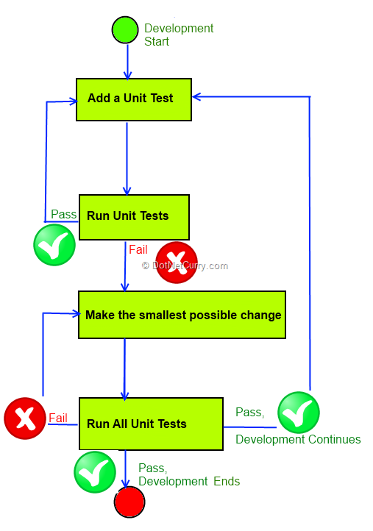

Slide 9
9.1 Regression Tests & Test Baselines
Integration Testing: refers to tests conducted to verify the interfaces and interactions between software components as they are integrated together with each other and legacy, library, COTS, and open-source modules in successively larger combinations defined by the software requirements and interface specification, (collections, builds, increments& programs.

Slide 10
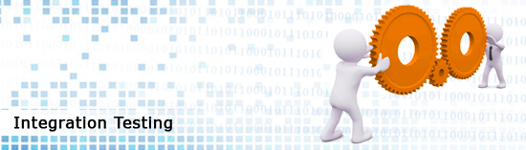

Slide 11
9.1 Regression Tests and Test Baselines:
System Testing: Refers to testing the completely integrated system to verify that it satisfies functional, performance, interface, and nonfunctional (availability, reliability, safety, security, etc.) requirements.

Slide 12
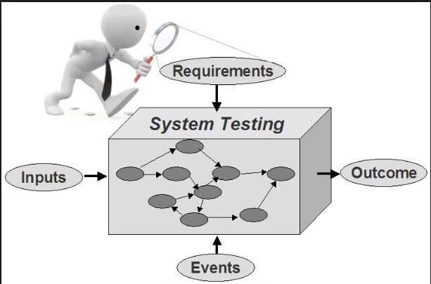

Slide 13
9.1 Regression Tests and Test Baselines:
System Integration Testing: refers to tests conducted to verify the interfaces and interactions between components as hardware and software are integrated together with each other and any external or third-party systems defined by the systems requirements into successively larger combinations such as subsystems.

Slide 14
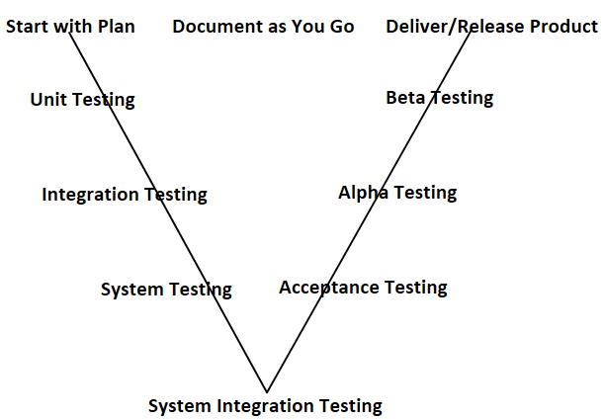

Slide 15


Slide 16
9.1 Regression Tests & Test Baselines
Regression Testing: Refers to test software releases to verify that modifications made to them have not caused any unintended effects. The software system and its components still satisfy it’s specified requirements and performs as intended. Run previously executed tests in sequence to check the system functions the same.

Slide 17
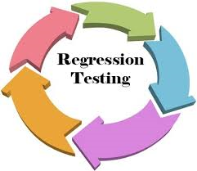

Slide 18
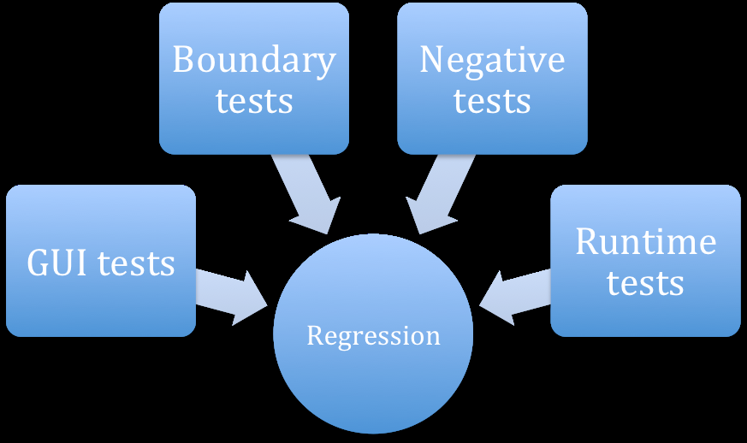

Slide 19
9.1 Regression Tests and Test Baselines:
Acceptance Testing: Refers to black-box testing conducted by the customer on a software system aimed at confirming that it satisfied its specifications and performs as expected on operational hardware prior to accepting transfer of ownership.

Slide 20


Slide 21


Slide 22
9.1 Regression Tests and Test Baselines:
Alpha Testing: Refers to testing conducted by an independent team to ensure that the software functions as expected and can be implemented with the same characteristics in its operational environment.

Slide 23
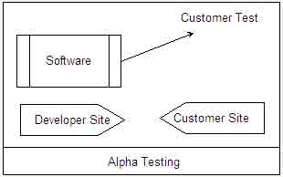

Slide 24
9.1 Regression Tests and Test Baselines:
Beta Testing: Refers to testing performed by external potential users aimed at ensuring that their needs are met. Typically, an independent group coordinates the tests conducted by outsiders and ensure that recommendations made by them are considered and potentially implemented.

Slide 25
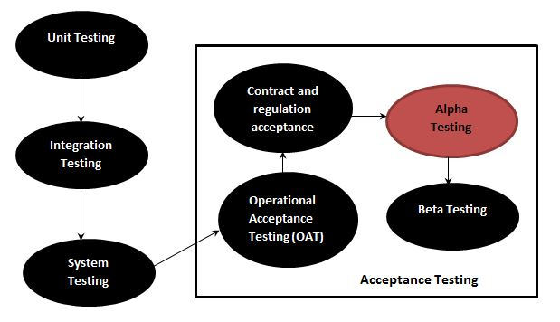

Slide 26
9.1 Regression Tests and Test Baselines:
Regression tests are run to ensure that the release executes as the users expect on their operational platforms. During these runs, you will need to verify that side effects are not present and operations will not be disturbed by the changes.

Slide 27
9.2 Revalidation and Qualification
Regression test fulfills a dual purpose. It revalidates the release:
1. will satisfy its requirements including those for external interfaces and any changes included and
2. will perform as intended after repairs have been made as configured/tailored for the user’s operation without any side effects.

Slide 28
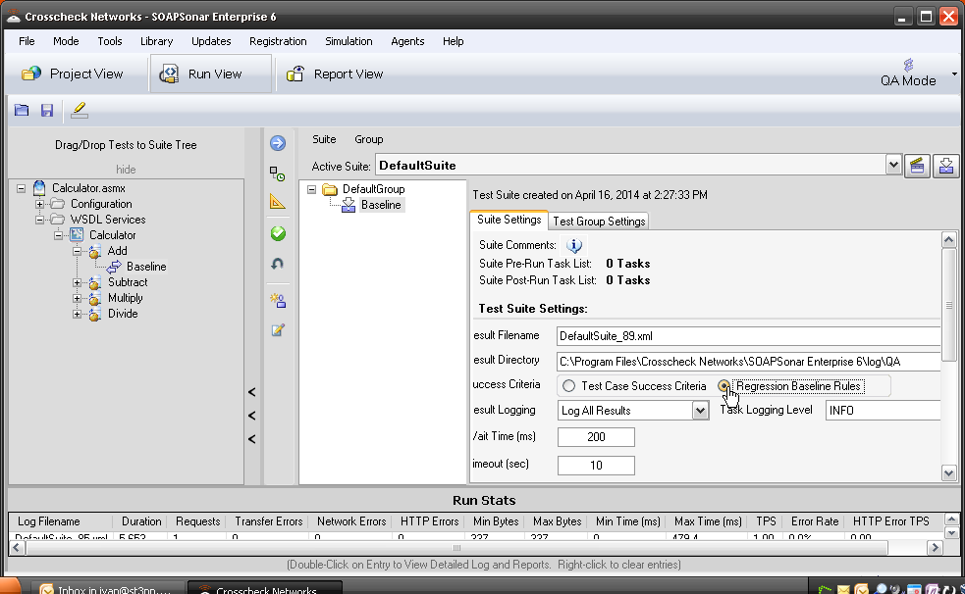

Slide 29
9.2 Revalidation and Qualification
It is highly recommended that regression tests be automated using scripts developed specifically for that purpose. Such scripts should also be designed to automatically compare results to expectations and highlight any differences found. This will simplify the testing process considerably fast, reusable and repeatable.

Slide 30
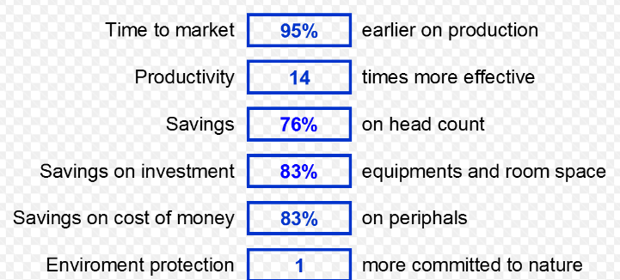
9.2 Revalidation and Qualification

Slide 31
9.3 Field Testing and Releases
Releases to the field are, by design, configured, adapted, and tailored to the needs of the operational facility. Field testing of releases is by its very nature intended to check out operational considerations like setup parameters and power up, boot and shutdown procedures.

Slide 32
9.3 Field Testing and Releases
Speed and performance of the application (response time, CUPU and memory utilization, etc.)
Data population ease (time to populate and verify application databases)

Slide 33
9.3 Field Testing and Releases
Ease of use (measures include time to launch and complete an application or the steps involved in exercising a feature or function.
Ease of learning (measures include time to learn to use features and functionality)

Slide 34
9.4 Field Support and Repairs
Field support functions that need to be performed by the software maintenance shop besides scheduling and dispatching technical personnel include following:
Establish a work order system that defines, tracks, and loses out trouble tickets

Slide 35
9.4 Field Support and Repairs
Creating a Web-based system to provide information to users/customers on field support issues and their resolution (including a frequently asked questions list)
Creating a customer database that records the history for each site in which the release is installed, including a patch history

Slide 36
9.4 Field Support and Repairs
Establishing a purchase order system and the means to track payments
Creation of a patch management system to track patches in the field
Patches must be approved by management.
Must used approved procedures and adequately documented and tested
Categorized as priority 1 defect first

Slide 37
SLA and Supplier Agreements Management
4.2.12 The SLA indicators are used for billing purposes
4.2.13 Raw data describing costs are available for some maintenance resources (personnel, systems, and contracts/licenses). Maintenance billing captures, presents, and explains the most important cost elements

Slide 38
10 Content-Based Annual Releases
10.1 Adaptive, Corrective, and Perfective Changes
Change to existing software releases is precipitated by actions taken to make adaptive (add new functions, address new platform, etc.) updates to the previous software release.

Slide 39
10 Content-Based Annual Releases
Stakeholders require the maintenance team to provide risk assessment, priorities, cost estimates especially when the changes involves potential commercial off-the-shelf (COTS) hardware and software updates and replacements.

Slide 40
10 Content-Based Annual Releases
They cannot include everything in the release because of resources limitations (time, money, staff, facility hours etc.)
The change control board assumes the stakeholders responsibilities in making content decisions.

Slide 41
10 Content-Based Annual Releases
Record/Classify- Stakeholders initiate a software change request (SCR) for changes or repairs. Defects in the field use the software trouble reports which identifies issues. The change control board (CCB) approves the changes.

Slide 42
10 Content-Based Annual Releases
Assess – The CCB tasks a technical team to assess the changes. Request are prioritized based on cost, impact, and implementation risk using the following similar scheme:

Slide 43
10 Content-Based Annual Releases
Priority 1 (Urgent) – must make a change in order to continue operations. Such as emergency repairs.
Priority 2 (Critical) – The change should be made without delay as it may be associated with a known defect that is seriously degrading system functionality or performance.

Slide 44
10 Content-Based Annual Releases
Priority 3 (Major) – The change should be made, but delays in the repair are tolerable.
Priority 4 (Minor) – The change should be made when there are time and resources to do it.

Slide 45
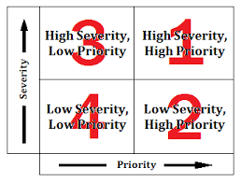

Slide 46
10 Content-Based Annual Releases
Plan – Stakeholders or CCB agrees on the priority of the issue for changes.
Implement – Stakeholders or CCB agree with the release plan and selected release schedules.
Close/Accept – Changes implemented should be tested and accepted as part of the release update cycle.

Slide 47
10 Content-Based Annual Releases
The normal configuration management process following the steps in Change Control Board (CCB) and process to rate the proposed changes based on an assessment of their impact and assignment priorities.

Slide 48
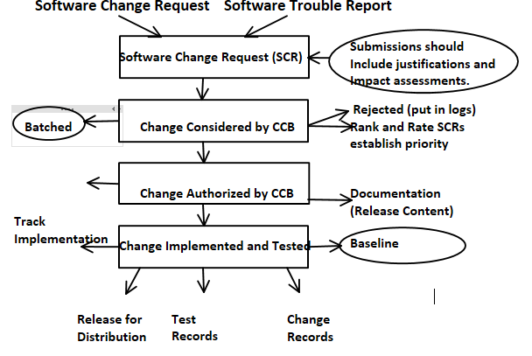

Slide 49
10 Content-Based Annual Releases
Change control board membership:
1. CCB Chair – Chair of the board
2. CCB – Stakeholders
3. Originator – Software Change Request
4. Evaluator – person or team
5. Implementation team – Project Lead
6. Verifier – Test team representative
7. Recorder – Person who publish minutes

Slide 50
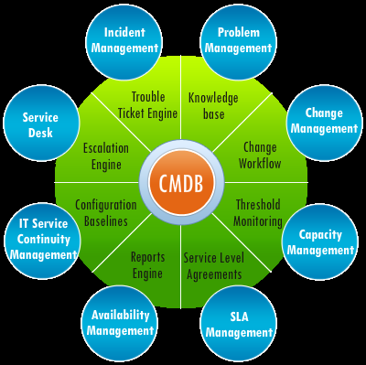

Slide 51
10 Content-Based Annual Releases
Adaptive maintenance: Modification of a software product performed after delivery to keep computer program usable in a changed or changing environment
Corrective maintenance: Reactive modification of a software performed after delivery to correct discovered faults.

Slide 52
10 Content-Based Annual Releases
Perfective maintenance: Modification of a software product performed after delivery to improve either its performance or maintainability.
Preventive maintenance: Modification of a software product after delivery to correct latent defects before they become problem. This often includes redesign, restructuring, or upgrade of the software to make it easier to maintain.

Slide 53
10 Content-Based Annual Releases
Platform maintenance: Modification of a software product after delivery to ensure that it runs with platform software (operating systems, database managers, utilities, drivers, etc.) that has been updated to incorporate manufacturer recommended changes.

Slide 54
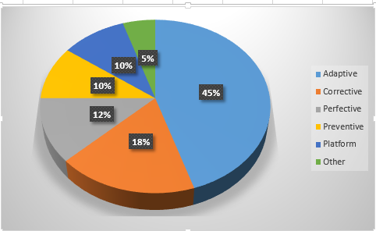

Slide 55
10 Content-Based Annual Releases
10.2 What Changes to Include, When, and Why
Starts with the basics – The basic ingredients revolve around the schedule and budget established for your release the number of SCRs that you have to process, metrics on your past performance and your backlog.

Slide 56
10 Content-Based Annual Releases
Add the essential stock – You need to start prioritizing the work that needs to be done assuming that you have estimated the number of SCRs that you can incorporate into the release.

Slide 57
10 Content-Based Annual Releases
Fill the pot – If you still have resources available in your plan at this point in time, you can add the remaining Priority 2,3 and 4 SCRs.
Stir as you cook – Before you start updating the software generate a map that identifies dependencies between modules.

Slide 58
10 Content-Based Annual Releases
Sample the results – The unexpected will occur as the release is being generated. Content will have to be added, deleted, and modified based on events, issues, and user/customer preferences. This approach allows you to set expectations so you can minimize surprises.

Slide 59
10 Content-Based Annual Releases
10.3 Focus on Quality
In commercial world, quality is king.
Software releases from a historical context, you see what many call the rolling wave model.
The number of SCRs lessening over time until the next big upgrade occurs.

Slide 60
10 Content-Based Annual Releases
There are many practices that can be used during software maintenance to continually improve software quality.
Those who work during development like peer reviews and code reading can be applied with minimal modification during maintenance.

Slide 61
10 Content-Based Annual Releases
10.4 Distribution Controls
Releases have to be configured, customized, and tailored for distribution to more than one site or geographic region.
For example, financial packages sold worldwide need to be customized to handle different tax laws and restrictions.

Slide 62
10 Content-Based Annual Releases
The practice of distribution control assume that the release being distributed has been baselined, and a master copy of the release and its associated regression tests and documentation have been placed in a physical repository under configuration control.

Slide 63
10 Content-Based Annual Releases
Many variations to these distribution practices occur.
Specialized install programs may be needed to comply with operating system vendor requirements that call for the established of specialized directories.

Slide 64
Research Paper Due
Research Paper due on
Nov 17th

Slide 65
Final Exam Group Project
Final Exam
Group Project Presentation in Class
December 1st & 8th

